Slide 1

Notes:
Add this anywhere in your Markdown file <style> section { background: '#ABF7CE'; font-family: 'DMSans-AID-Headline', 'DMSans-AID-Text'; } </style> HD 1280 x 720 13.333 7.5 Full HD 1920 x 1080 19.999 11.25 Quad HD 3840 x 2160 39.999 22.50 4K 4096 x 2160 42.664 22.50 https://docs.decksetapp.com/English.lproj/Formatting/13-auto-scaling.html

Slide 2
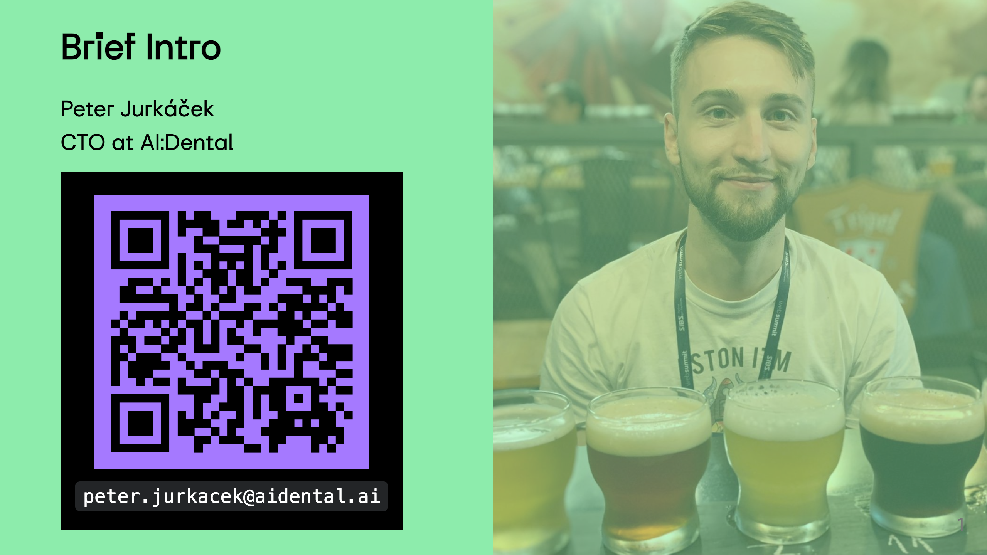
Notes:
References https://www.ncbi.nlm.nih.gov/pmc/articles/PMC8238744/ https://pubmed.ncbi.nlm.nih.gov/30861309/ https://www.ncbi.nlm.nih.gov/pmc/articles/PMC9026102/ https://www.ncbi.nlm.nih.gov/pmc/articles/PMC5334326/ https://www.researchgate.net/publication/ (1996 Room for improvement? The accuracy of dental practitioners who diagnose bony pathoses with radiographs)[https://pubmed.ncbi.nlm.nih.gov/8665324/]

Slide 3
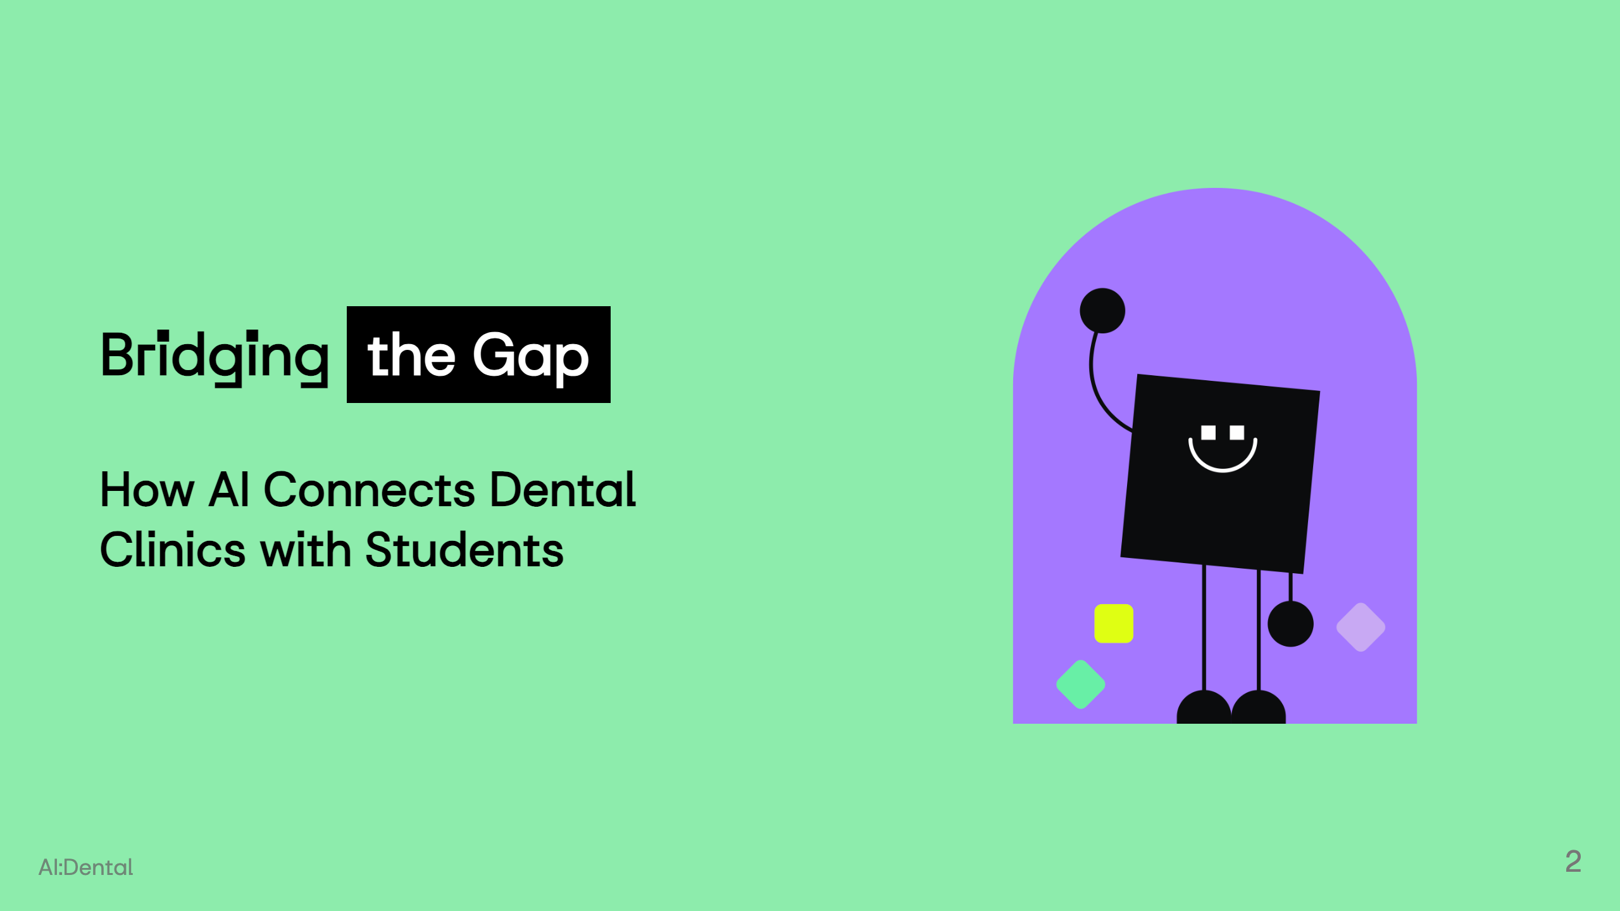
Notes:
--- To democratize dental health through AI by enhancing precision, affordability, and accessibility in education and patient care. Shaping the future of the dentistry through creating the conditions for everyone to access the affordable and personalised healthcare.

Slide 4
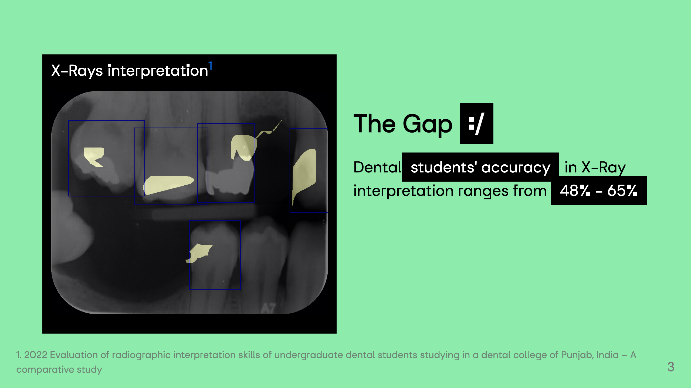
Notes:
![](img/qexample.png)

Slide 5
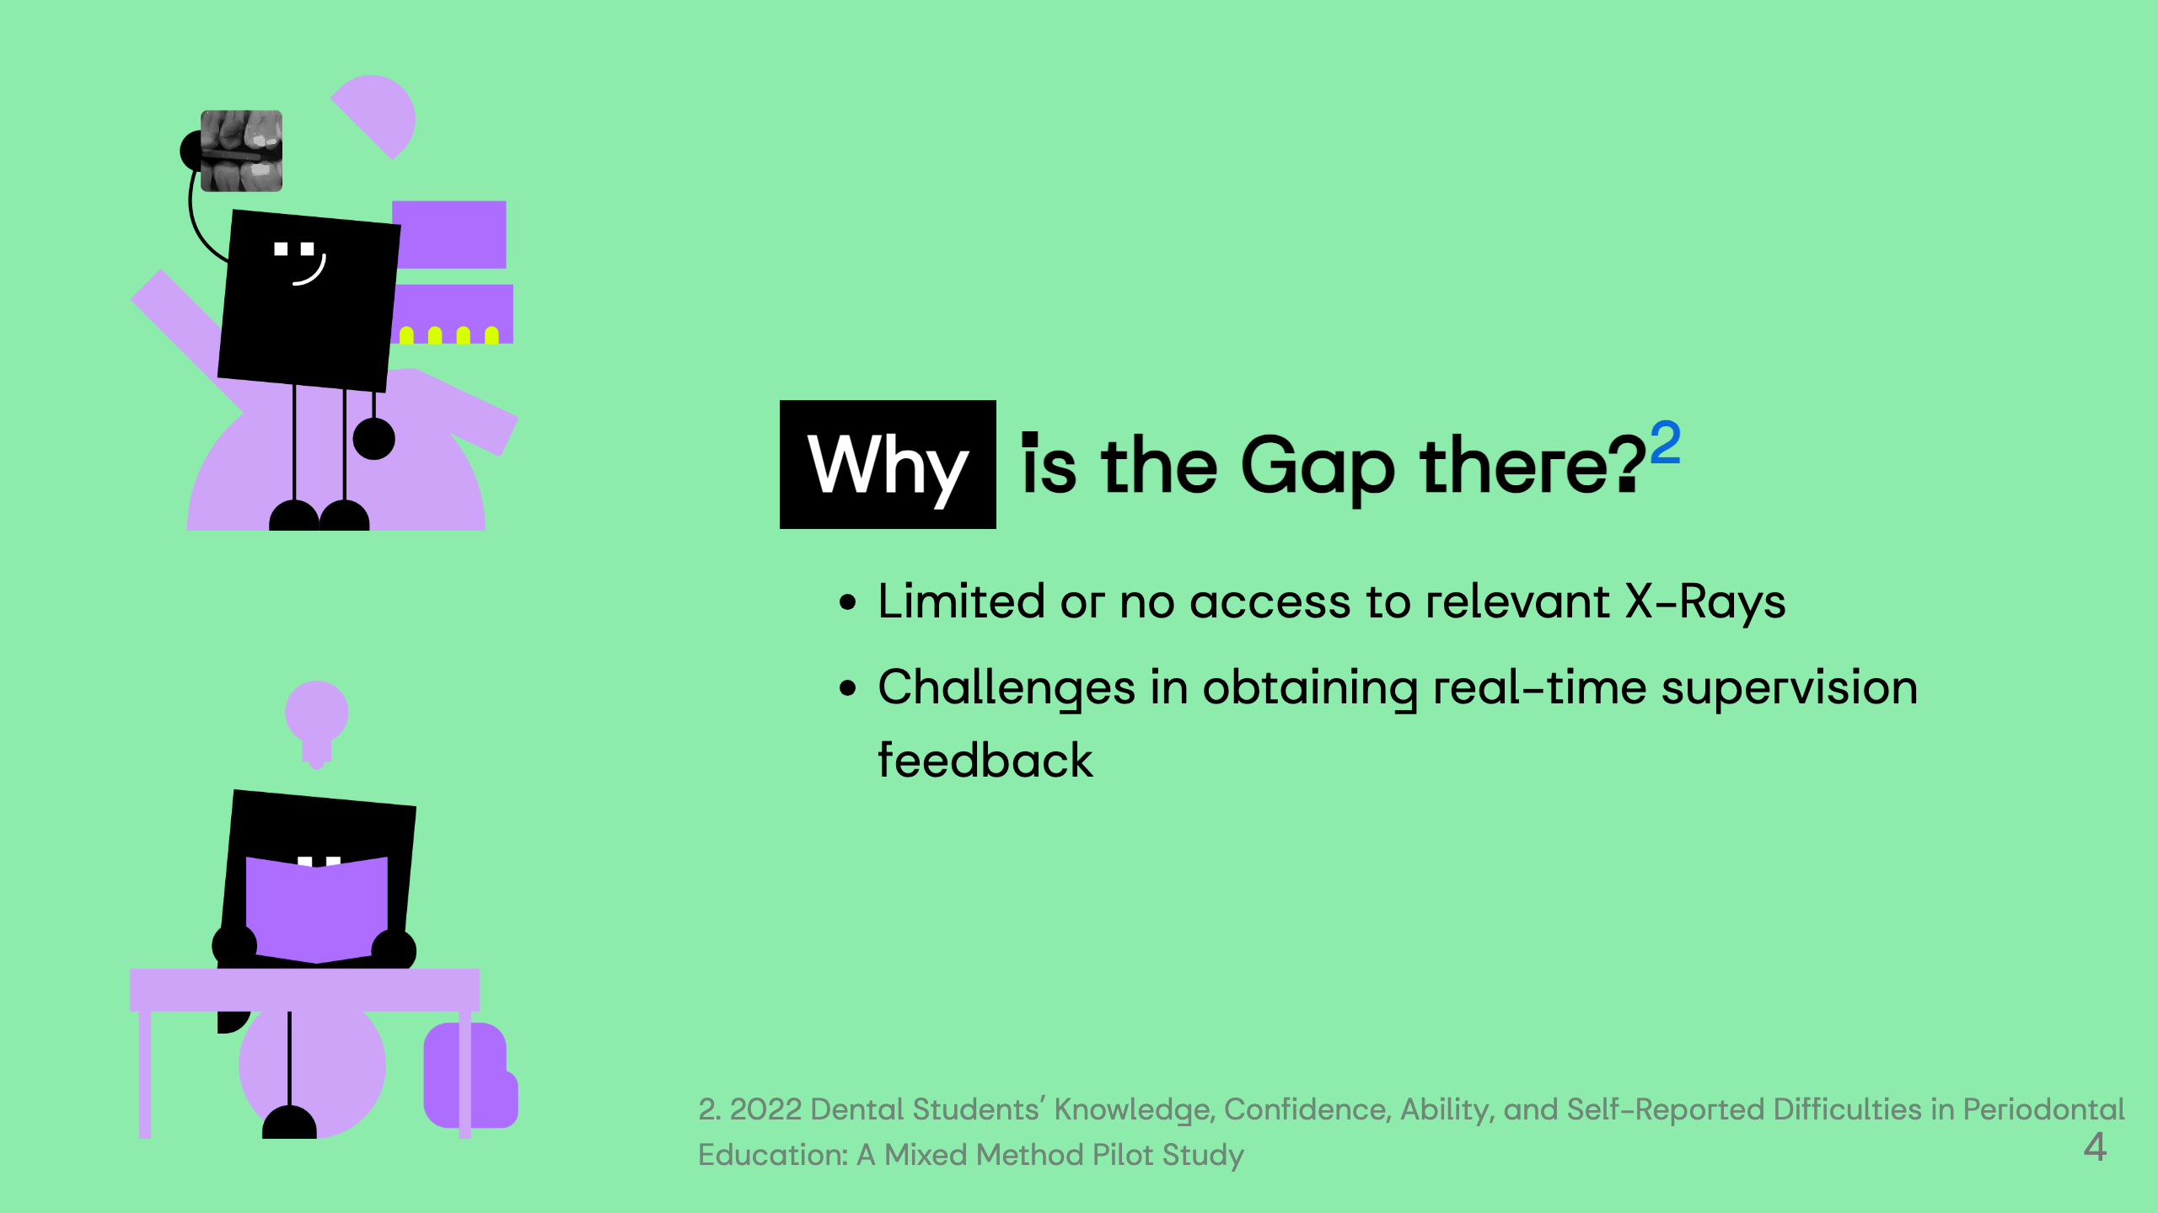

Slide 6
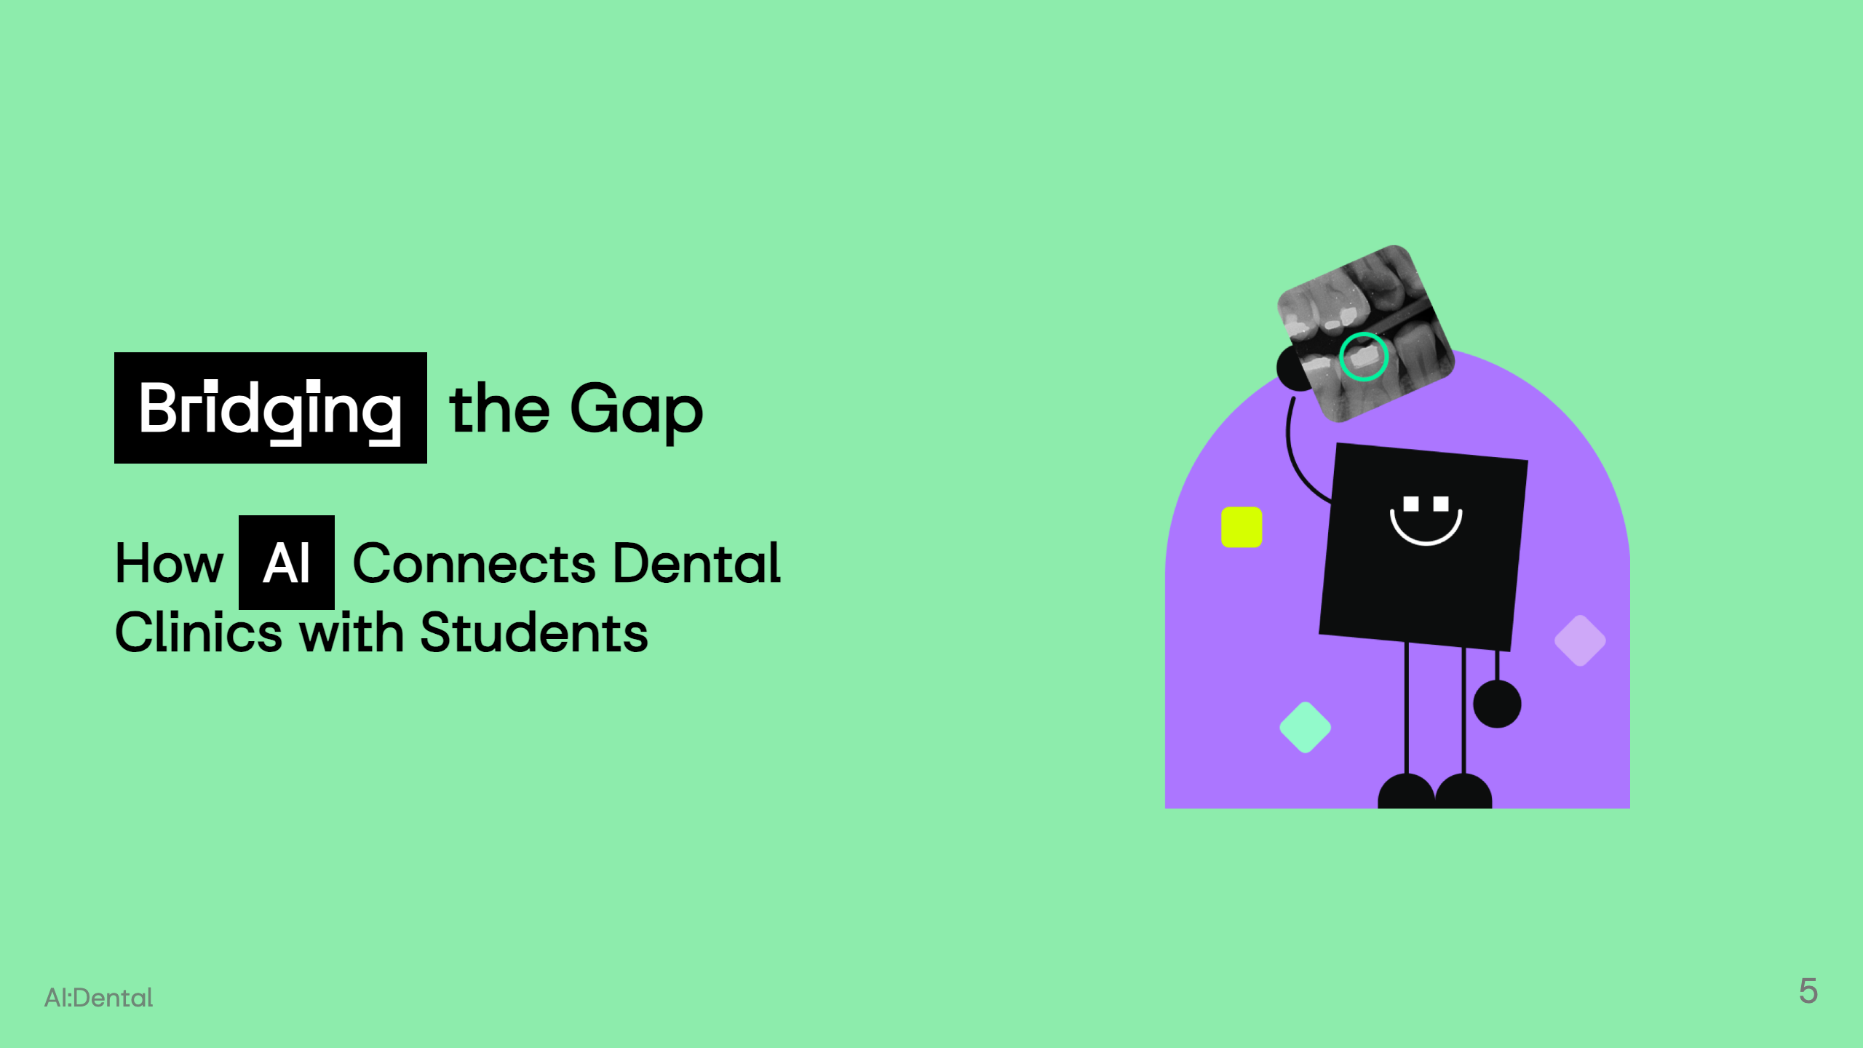

Slide 7
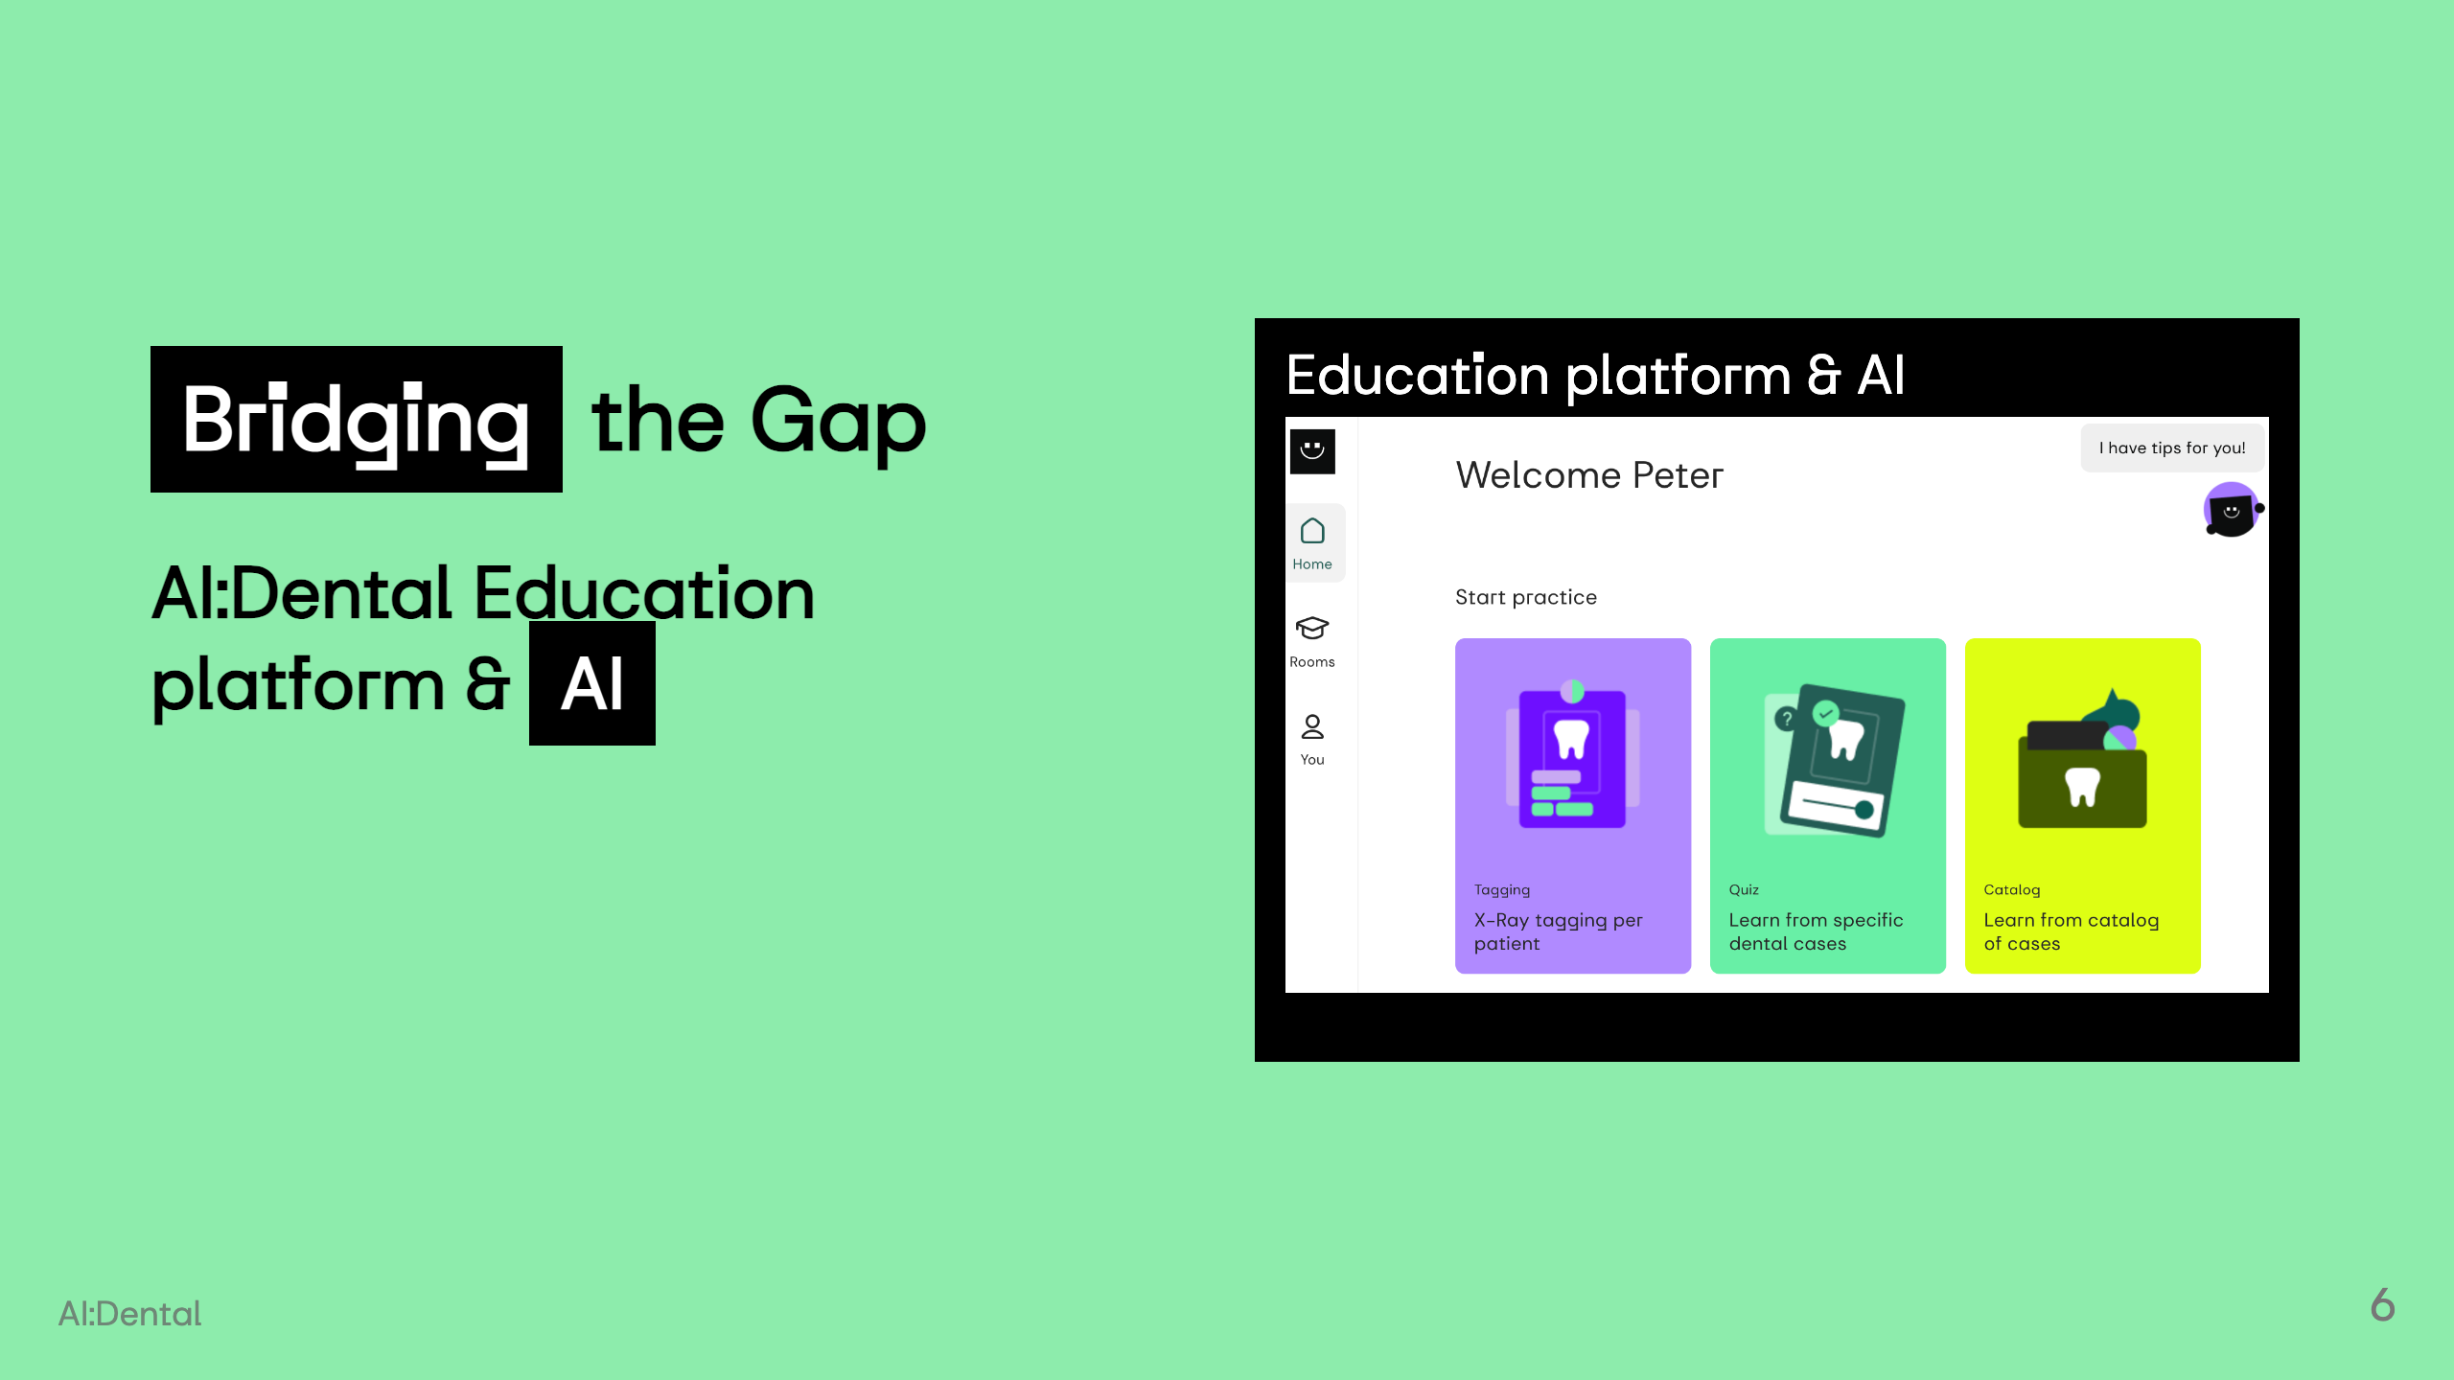

Slide 8
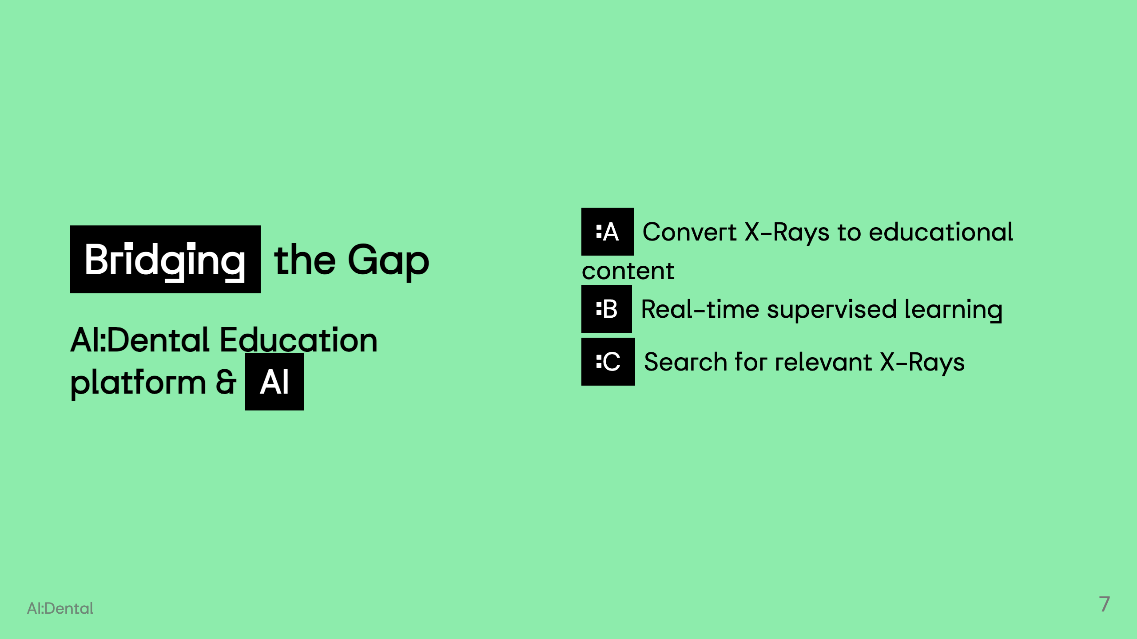

Slide 9
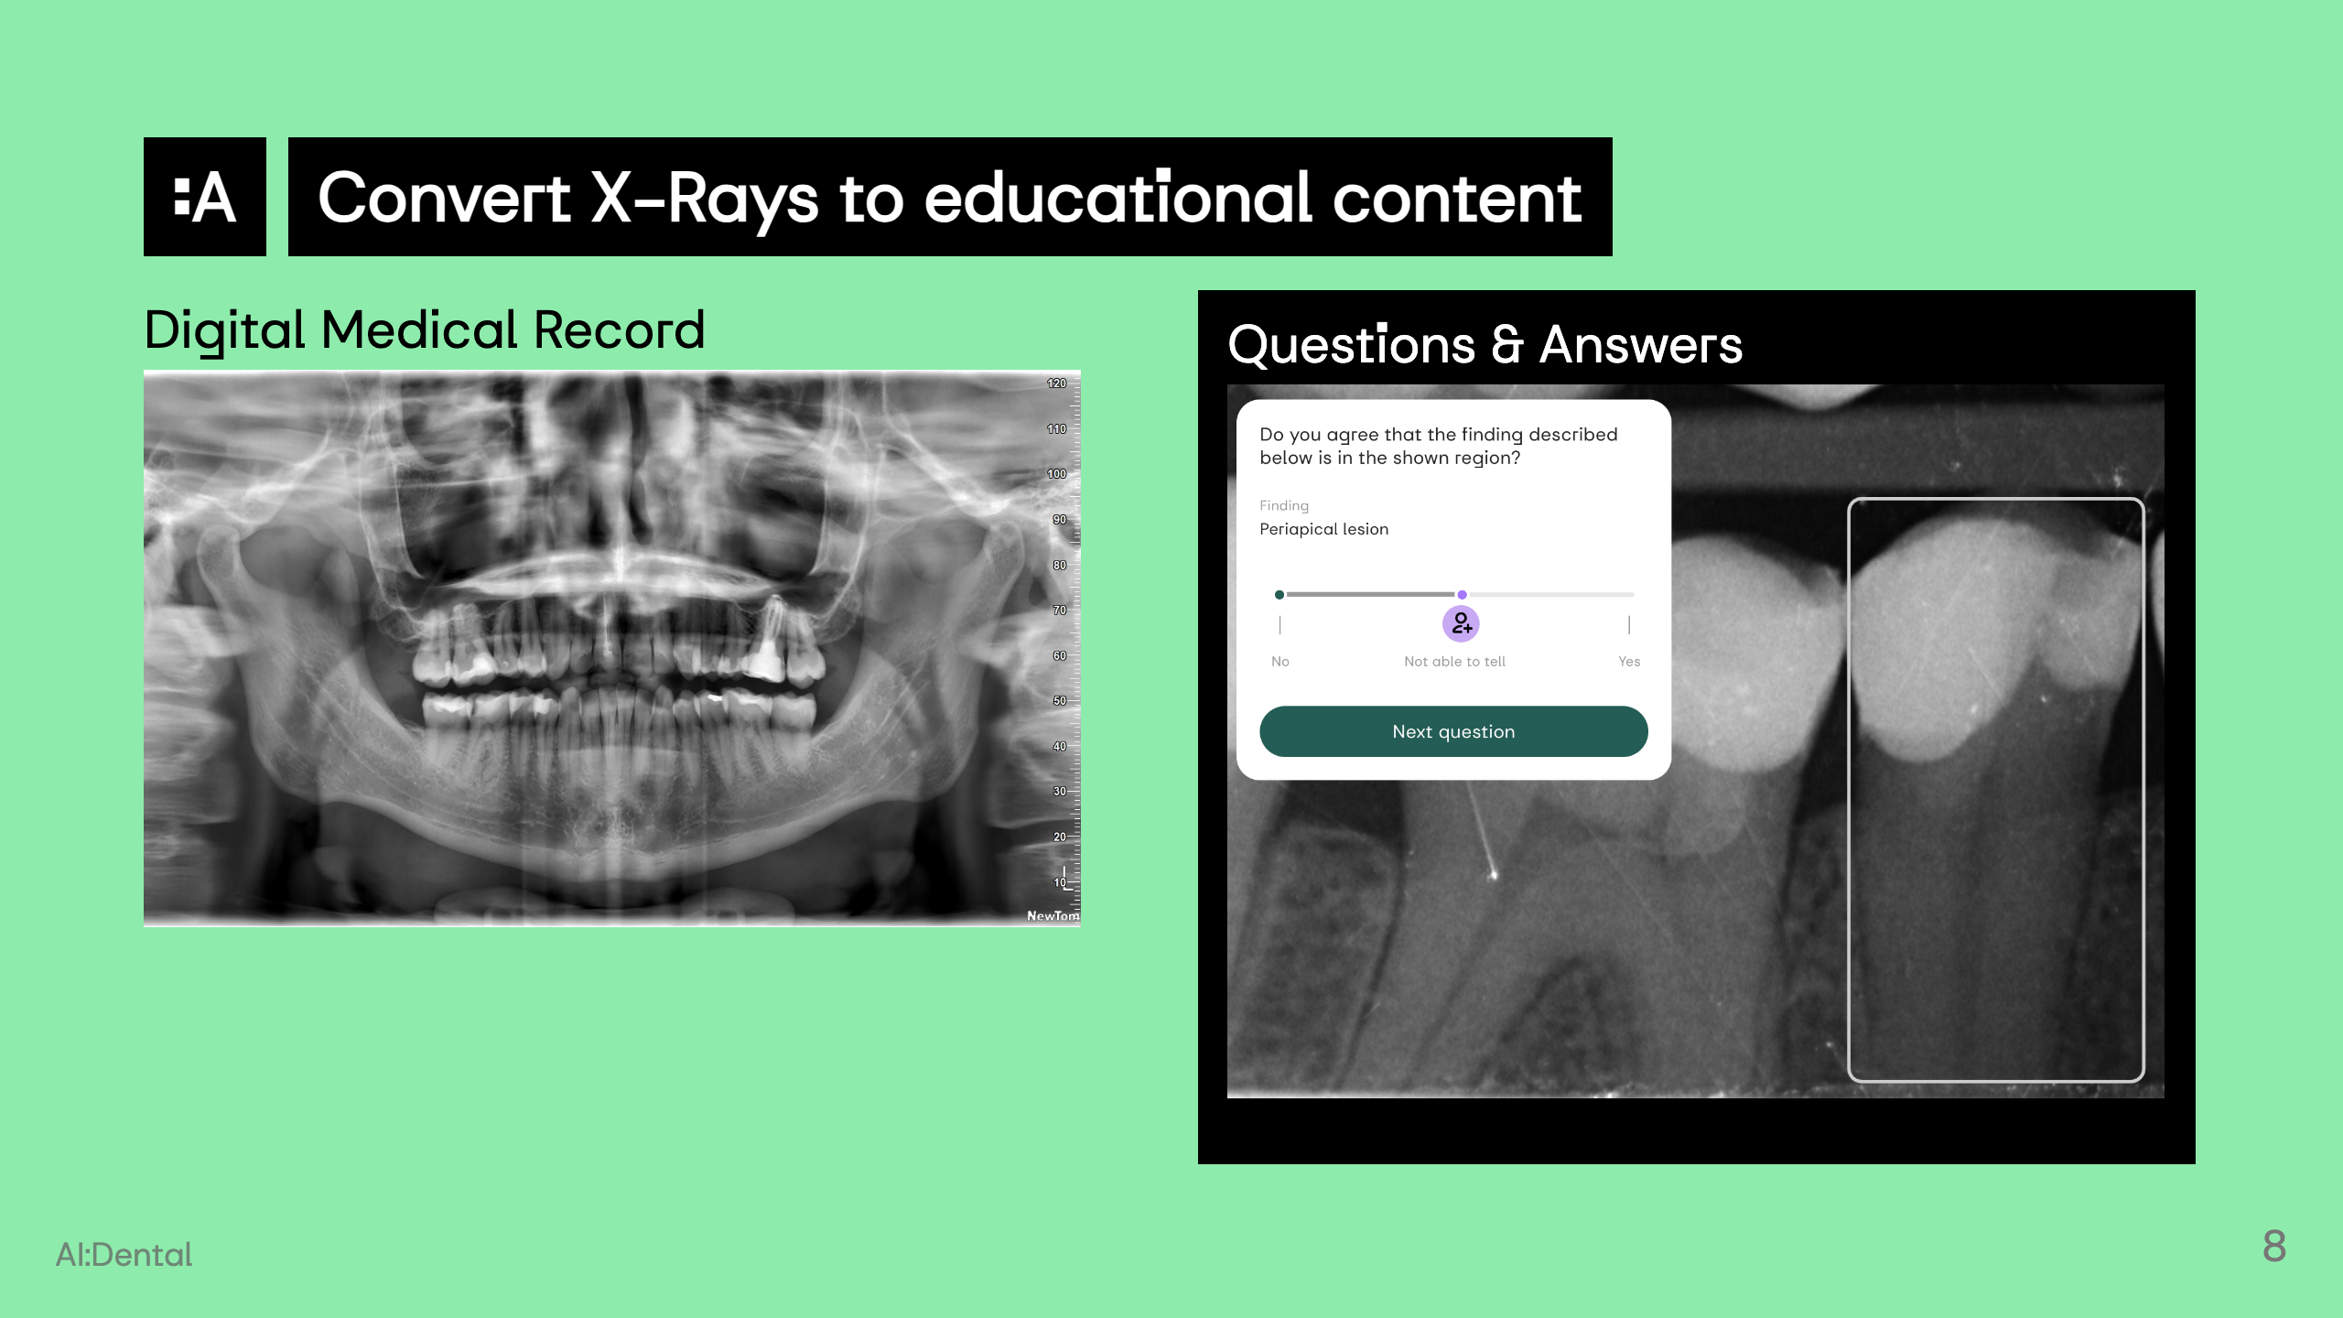
Notes:
![w:256](EMR_semafor.png)

Slide 10
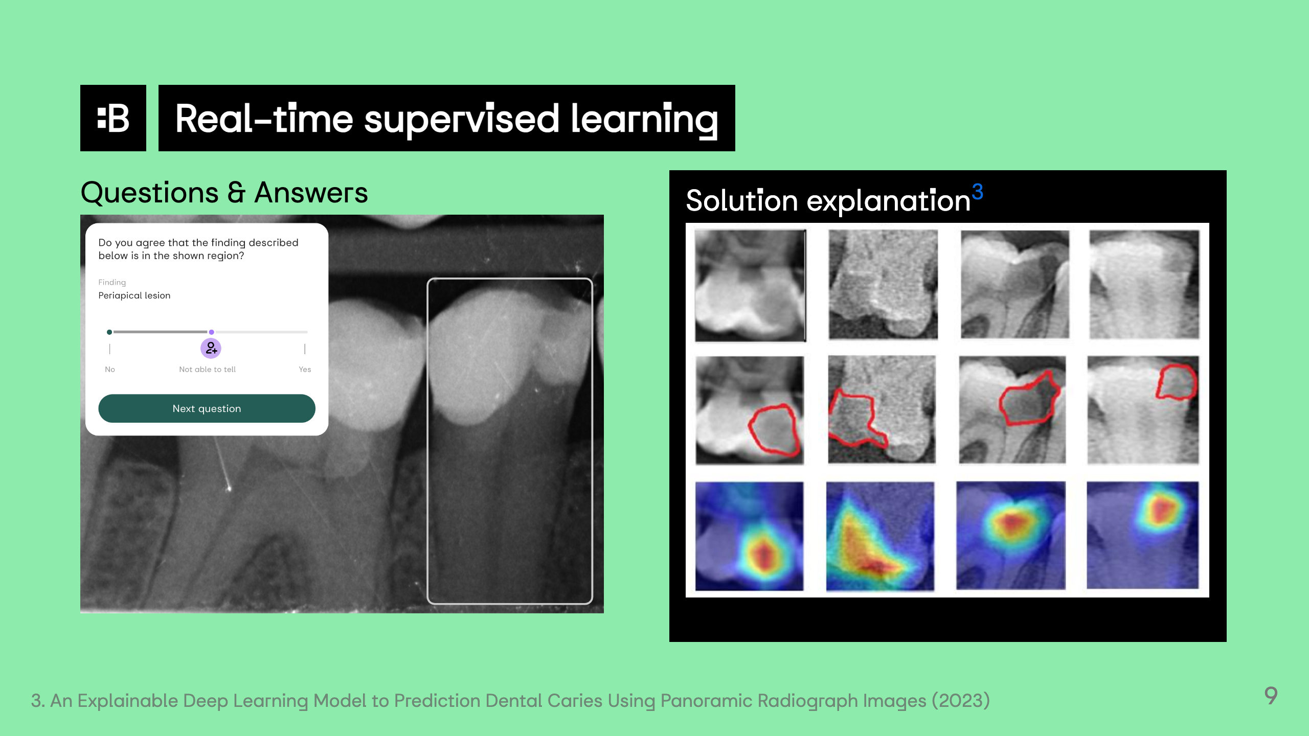

Slide 11
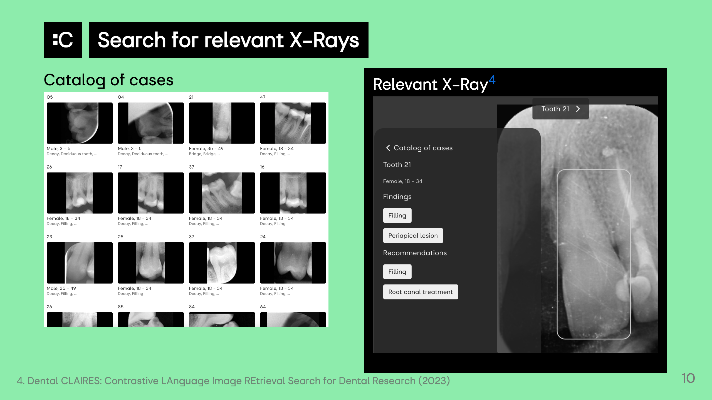
Notes:
https://www.sciencedirect.com/science/article/pii/S2772442523001491 https://www.mdpi.com/2075-5309/13/2/275 https://www.ncbi.nlm.nih.gov/pmc/articles/PMC10283104/

Slide 12
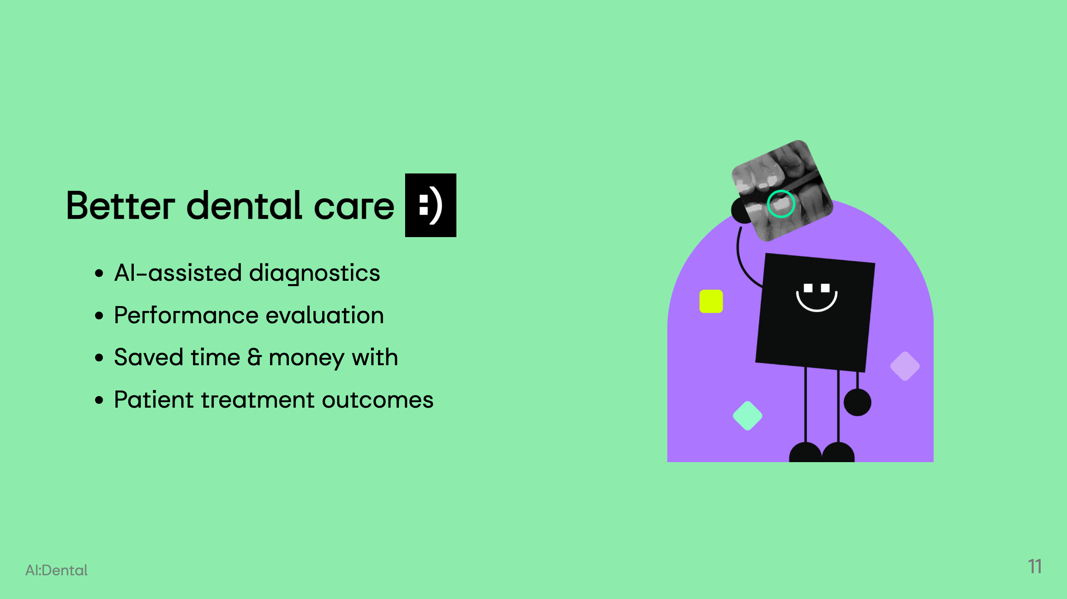
Notes:
<div class="columns"> <div> </div> <div> <!-- <iframe width="420" height="315" src="https://www.youtube.com/embed/tgbNymZ7vqY"> </iframe> </div> </div>

Slide 13
